Slide 1
Effective Classroom Management: Creating a Positive Learning Environment
Notes:
Created from: https://docs.google.com/document/d/1-X7v0XMBomv9xZqkPMFDTMU3yPCclElfMwcaDDU1Em0/edit

Slide 2
What is Classroom Management?
The methods and strategies used to create and maintain an orderly learning environment
Encompasses behavior management, physical space organization, and instructional techniques
Aims to maximize student engagement and minimize disruptions
Why do you think classroom management is important?

Slide 3
Key Components of Classroom Management
Clear expectations and rules
Consistent routines and procedures
Positive reinforcement and consequences
Effective communication
Engaging lesson planning
How might these components work together to create a well-managed classroom?

Slide 4
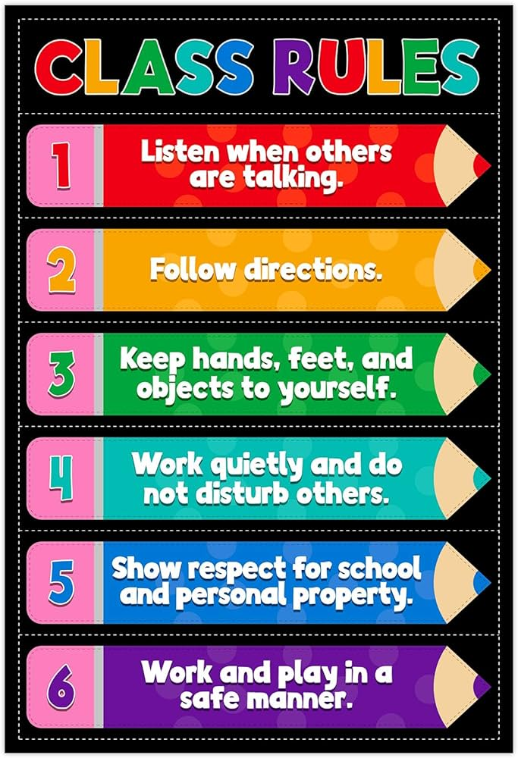
Establishing Rules and Expectations
Involve students in creating classroom rules
Keep rules simple, clear, and positively stated
Post rules visibly in the classroom
Consistently enforce rules and expectations
What are some effective rules you've experienced in your own education?

Slide 5
Creating Routines and Procedures
Develop procedures for common classroom activities
Teach and practice routines at the beginning of the year
Use visual aids to reinforce procedures
Adjust routines as needed throughout the year
How do you think routines contribute to a well-managed classroom?

Slide 6
Positive Reinforcement Strategies
Verbal praise and encouragement
Token systems or reward charts
Special privileges or responsibilities
Positive notes home to parents
Why is positive reinforcement important in classroom management?

Slide 7
Addressing Misbehavior
Use non-verbal cues to redirect minor misbehavior
Implement a tiered system of consequences
Address issues privately when possible
Focus on the behavior, not the student
How can addressing misbehavior respectfully impact the classroom environment?

Slide 8
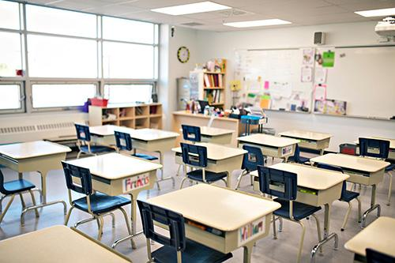
Organizing the Physical Space
Arrange desks to facilitate learning and minimize distractions
Create designated areas for different activities
Ensure materials are easily accessible
Consider traffic flow and sightlines
How might the physical layout of a classroom affect student behavior and learning?

Slide 9
Building Positive Relationships
Get to know your students individually
Show genuine interest in their lives and experiences
Use humor appropriately
Be fair and consistent in your interactions
Why do you think positive teacher-student relationships are crucial for effective classroom management?

Slide 10
Engaging Instructional Strategies
Use a variety of teaching methods to cater to different learning styles
Incorporate active learning strategies
Provide opportunities for student choice and voice
Use technology to enhance engagement
How can engaging instruction help prevent behavior issues?

Slide 11
Continuous Improvement
Regularly reflect on your classroom management strategies
Seek feedback from students, colleagues, and mentors
Stay updated on new research and best practices
Be willing to adapt and try new approaches
What strategies will you use to continually improve your classroom management skills?

