Slide 1
Creating a Positive Classroom Environment
Notes:
Created from: https://docs.google.com/document/d/1-X7v0XMBomv9xZqkPMFDTMU3yPCclElfMwcaDDU1Em0/edit

Slide 2
What is a Positive Classroom Environment?
A space where students feel safe, respected, and motivated to learn
Promotes academic, social, and emotional growth
Characterized by positive relationships between teachers and students
How would you describe your ideal classroom environment?

Slide 3
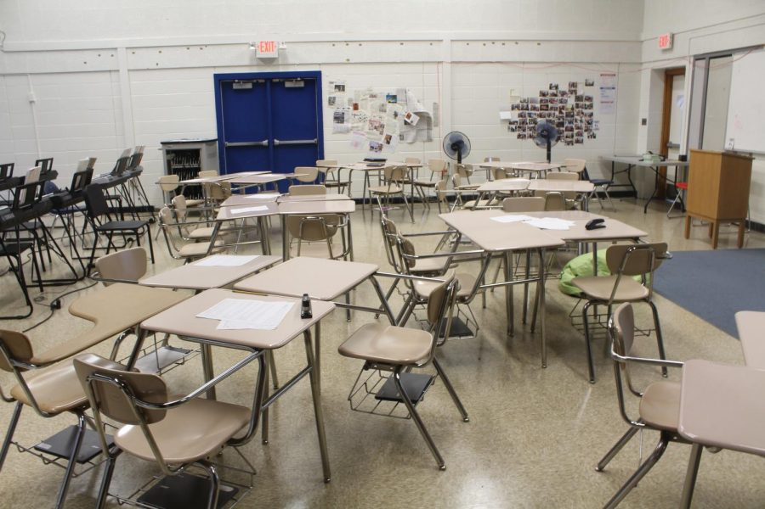
Key Elements of a Positive Classroom
Mutual respect and trust
Clear expectations and routines
Engaging and inclusive curriculum
Opportunities for student voice and choice
Supportive and encouraging atmosphere
What element do you think is most important? Why?

Slide 4
Building Positive Relationships
Get to know your students as individuals
Show genuine interest in their lives and experiences
Use positive reinforcement and encouragement
Be fair and consistent in your interactions
Model respectful behavior
How can you contribute to building positive relationships in class?

Slide 5
Creating a Safe Learning Environment
Establish clear rules and consequences
Address bullying and disrespectful behavior promptly
Encourage open communication
Celebrate diversity and promote inclusion
Provide emotional support when needed
What makes you feel safe in a classroom?

Slide 6
Fostering Student Engagement
Use varied and interactive teaching methods
Incorporate student interests into lessons
Provide opportunities for hands-on learning
Encourage student collaboration and discussion
Offer choices in assignments and projects
What types of activities engage you most in class?

Slide 7
Promoting Growth Mindset
Emphasize effort over innate ability
Teach that mistakes are opportunities for learning
Provide specific, constructive feedback
Encourage goal-setting and self-reflection
Celebrate progress and improvement
How can having a growth mindset help you in school and life?

Slide 8
Managing Classroom Behavior
Set clear expectations from the beginning
Use positive reinforcement for good behavior
Address misbehavior consistently and fairly
Teach and practice conflict resolution skills
Focus on solutions rather than punishments
What strategies help you stay focused and behave well in class?

Slide 9
Creating an Inclusive Classroom
Represent diverse perspectives in curriculum
Use inclusive language and examples
Accommodate different learning styles and needs
Encourage respect for all backgrounds and identities
Address and prevent discrimination
How can you help make your classroom more inclusive?

Slide 10
The Role of Physical Environment
Arrange seating to promote interaction
Display student work and motivational messages
Ensure good lighting and comfortable temperature
Create designated spaces for different activities
Keep the classroom clean and organized
How does the physical environment affect your learning?

Slide 11
Working Together for a Positive Classroom
Remember, creating a positive environment is a team effort
Be open to giving and receiving feedback
Participate actively in class discussions and activities
Support and encourage your classmates
Take responsibility for your own learning and behavior
What will you do to contribute to a positive classroom environment?

